Slide 1

Goldbach’s Conjecture Analysis
Author: Tuan Bui
Stony brook university
AMS 325

Slide 2
Abstract
My presentation indicates the application of using the sieve of Eratosthenes method to find Goldbach pairs.
I also present my view of Goldbach’s comet in different classes.
The main analysis project is built using Python.
I also use the Regression model in R.

Slide 3
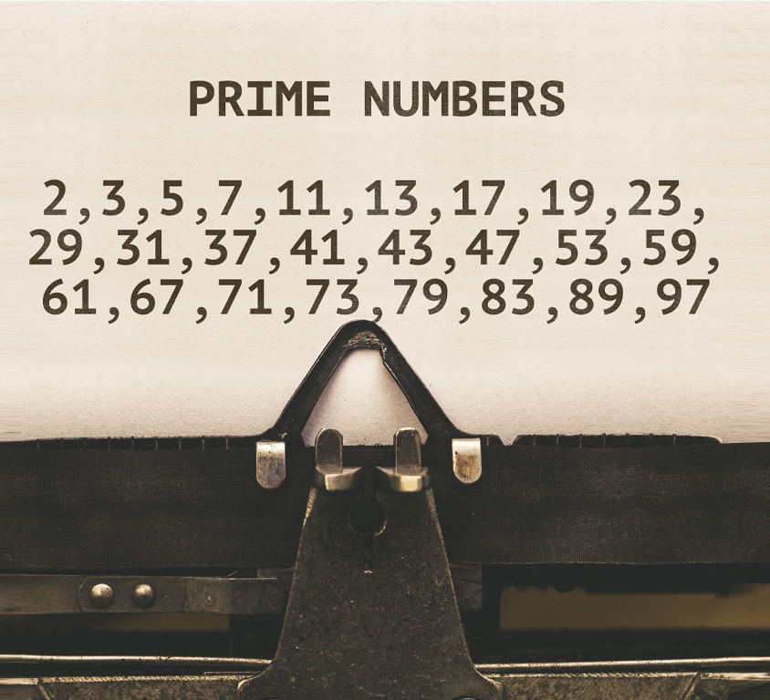
Prime Numbers
A whole number greater than 1 whose only factors are 1 and itself.

Slide 4
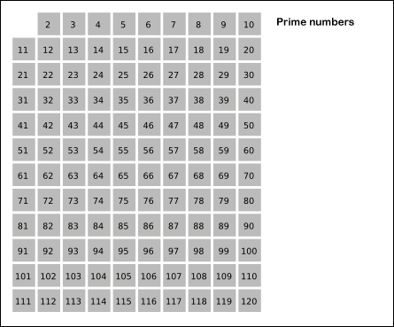
Sieve of Eratosthenes
An ancient algorithm for finding all prime numbers up to any given limit.
Iteratively mark all multiples of each prime number, starting with the first prime number, 2.
The remaining unmarked numbers are primes.
Sieve of Eratosthenes animation

Slide 5


Sieve of Eratosthenes
Proof:
Suppose a positive integer $n$ is not prime, then $n$ is composite.
Call: $n=ab$, for some integers $a,b$ with $1<a≤b$.
Assume $a>\sqrt{n},$then $ab≥a^{2}>n$, a contradiction.
Hence, the statement holds by contradiction. ∎
Only need to check to $\sqrt{n}$.

Slide 6
Algorithm
Create a boolean list for all numbers from 0 to n based on indices.
True will be assigned as the initial values.
Assign False for 0, 1, and all multiple of primes.
Convert the indices to a prime number list.

Slide 7
import time
# sieve method function
def sieve(n):
# time when the program start
start = time.time()
# Create a (n+1)-element True array (tempurary prime list)
prime_list_temp = [True for i in range (n+1)]
# Create a empty prime list
prime_list = []
# 0 and 1 are not prime
prime_list_temp[0] = False
prime_list_temp[1] = False
# Find an estimate square root of n
for est_sq in range(n):
if est_sq*est_sq >= n:
break
# Assign False for composites
for prime in range(2, est_sq):
if prime_list_temp[prime]:
# Assign False (not prime) for multiple of prime number
for num in range(prime*prime, n+1, prime):
prime_list_temp[num] = False
# Add True index in prime_list_temp
for prime in range(n+1):
if prime_list_temp[prime]:
prime_list.append(prime)
#time when the prime end
end = time.time()
print("Elapsed time for sieve method: {}".format(end - start))
# time that the program take to run
return end - start
import time
from sympy import isprime
# compute a prime list using sympy.isprime() function
def sympy_isprime(n):
# start time
start = time.time()
# Empty list to save output
prime_list = []
for num in range (2, num+1):
# Check every number from 2 to n is prime
if isprime(num):
# save prime
prime_list.append(num)
# end time
end = time.time()
print("Elapsed time for sympy.isprime() function: {}".format(end - start))
# return elapsed time
return end - start
Notes:
Using the time function in time library to get the time when the program starts and ends
n is upper bound number
Assign initial true value for all number from 0 to n
0 and 1 are not prime then assign False value
Find estimated sqrt of n

Slide 8
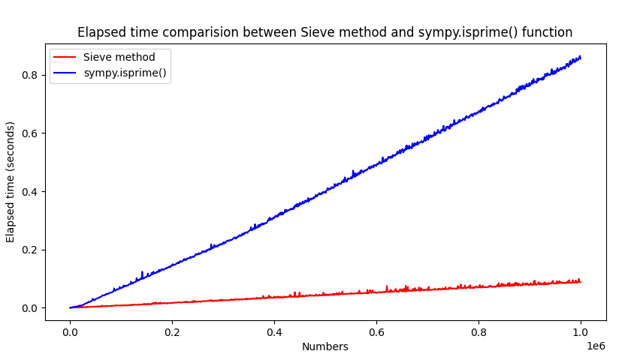

Slide 9
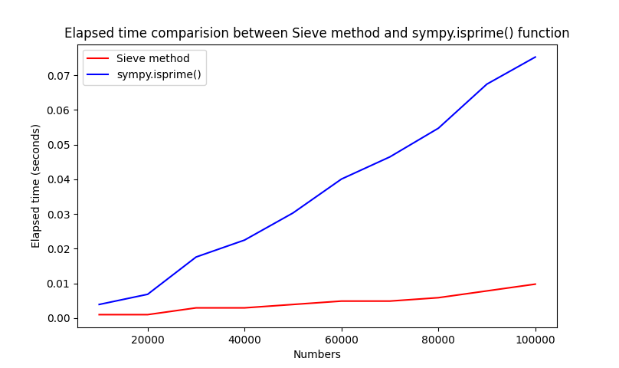
Number: 10000
Elapsed time for sieve method: 0.0009772777557373047
Elapsed time for sympy.isprime() function: 0.003908634185791016
Number: 20000
Elapsed time for sieve method: 0.000978231430053711
Elapsed time for sympy.isprime() function: 0.0068399906158447266
Number: 30000
Elapsed time for sieve method: 0.002931356430053711
Elapsed time for sympy.isprime() function: 0.017588376998901367
Number: 40000
Elapsed time for sieve method: 0.002931356430053711
Elapsed time for sympy.isprime() function: 0.022474050521850586
Number: 50000
Elapsed time for sieve method: 0.0039081573486328125
Elapsed time for sympy.isprime() function: 0.030291318893432617
Number: 60000
Elapsed time for sieve method: 0.004885673522949219
Elapsed time for sympy.isprime() function: 0.040062665939331055
Number: 70000
Elapsed time for sieve method: 0.004885435104370117
Elapsed time for sympy.isprime() function: 0.046460866928100586
Number: 80000
Elapsed time for sieve method: 0.005862712860107422
Elapsed time for sympy.isprime() function: 0.05471968650817871
Number: 90000
Elapsed time for sieve method: 0.00781702995300293
Elapsed time for sympy.isprime() function: 0.06742286682128906
Number: 100000
Elapsed time for sieve method: 0.009771585464477539
Elapsed time for sympy.isprime() function: 0.07523965835571289

Slide 10
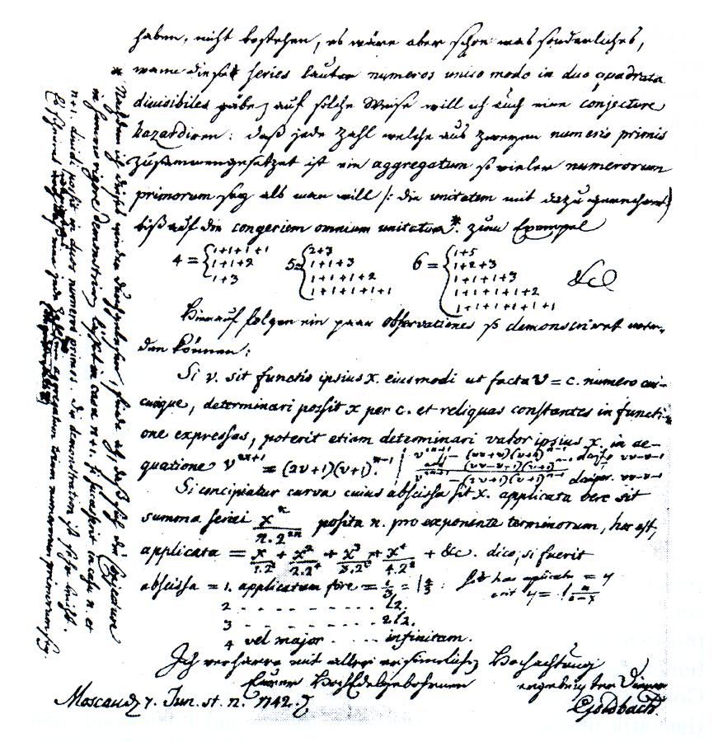

Goldbach’s Strong Conjecture
“Every natural even number greater than two is the sum of two prime numbers.”
T. Oliveira e Silva ran a distributed computer search that has verified the conjecture up to $4×{10}^{18}$ and double-checked up to $4×{10}^{17}$ in 2013.
Letter from Goldbach to Euler
dated on 7 June 1742 (Latin-German)
Notes:
280 years no answer

Slide 11
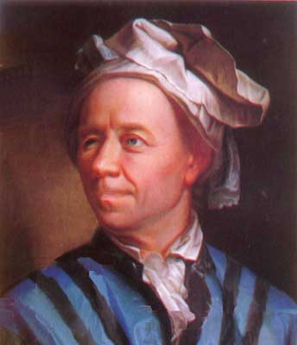
Goldbach’s Weak Conjecture
“Every odd number greater than 5 can be expressed as the sum of three primes.”
“Every odd number greater than 7 can be expressed as the sum of three odd primes.”
Proven in 2013 by Harald Helfgott, a Peruvian mathematician.
Christian Goldbach
(18 March 1690 – 20 November 1764)

Slide 12


Goldbach’s Weak Conjecture
Called "weak" because if the strong conjecture is proven, then it would be also true.
A consequence of the strong one because …
Suppose $n$ is a number greater than 5, then $n−3$ is greater than 2.
Thus, if the strong conjecture is true, then $n−3=p+q, for some prime numbers p,q.$
Harald Helfgott

Slide 13
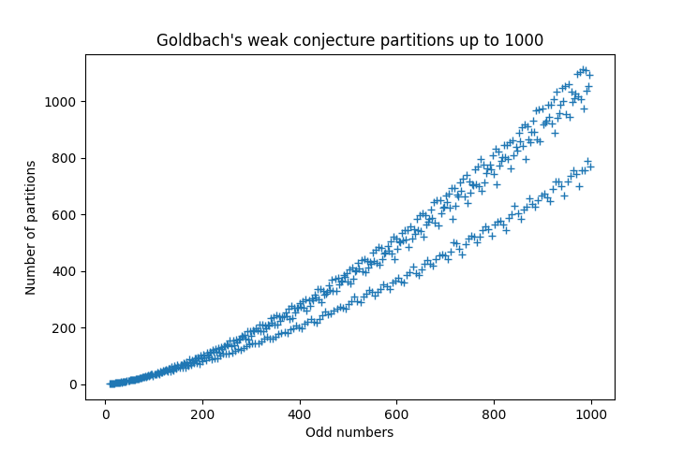
Goldbach’s Weak Conjecture Partitions Distribution
9 [(3, 3, 3)]
11 [(3, 3, 5)]
13 [(3, 3, 7), (3, 5, 5)]
15 [(3, 5, 7), (5, 5, 5)]
…
999 [(3, 5, 991), …, (71, 359, 569),
(71, 419, 509), …, (139, 229, 631),
(139, 241, 619), …, (157, 409, 433),
(157, 421, 421), …, (313, 313, 373),
(313, 337, 349), (331, 331, 337)

Slide 14
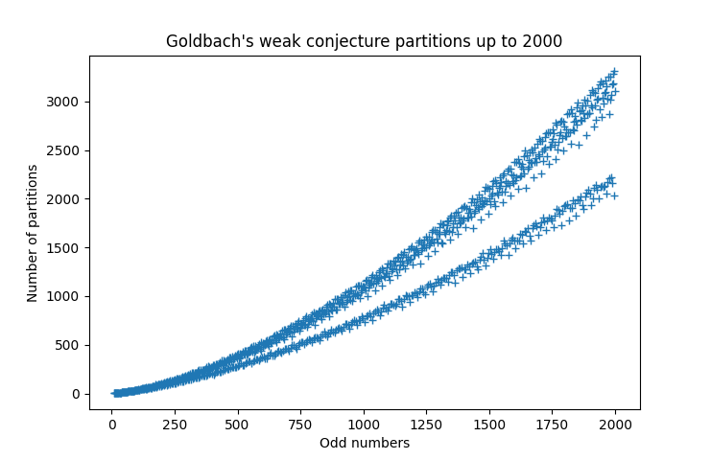

Slide 15
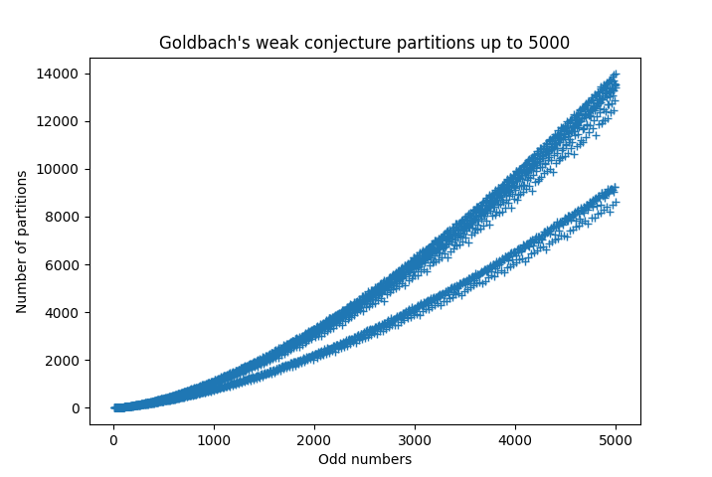

Slide 16
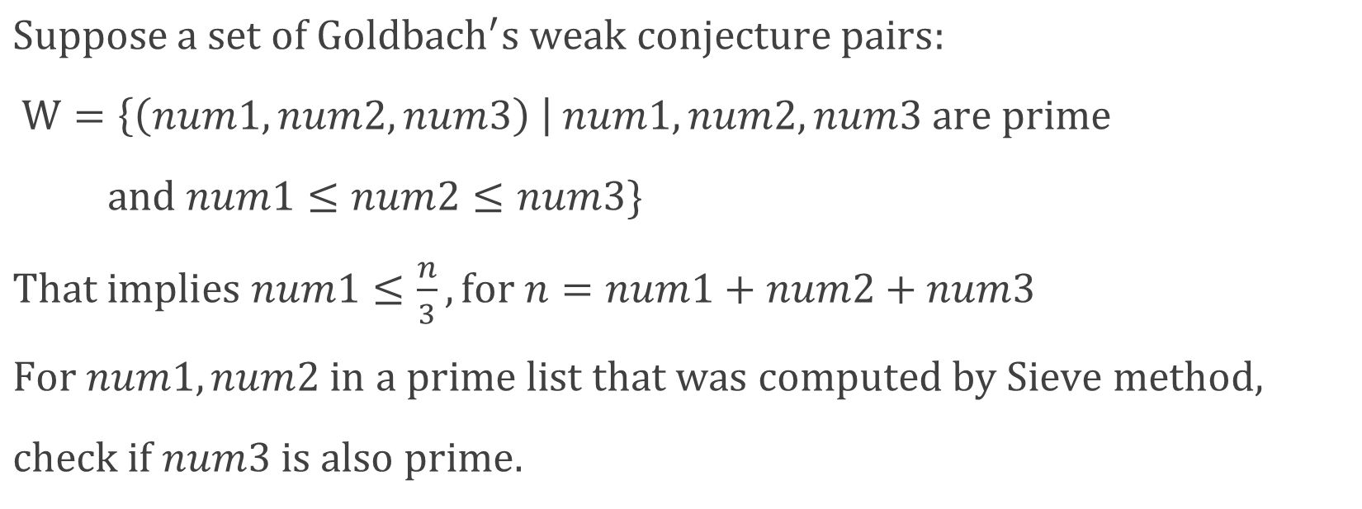
Algorithm
$Suppose a set of Goldbach^{′}s weak conjecture pairs:$
$W=\left\{\left(num1, num2, num3\right) \right| num1, num2, num3 are prime$
$and num1≤num2≤num3\}$
$That implies num1≤\frac{n}{3}, for n=num1+num2+num3$
$For num1, num2 in a prime list that was computed by Sieve method,$
$check if num3 is also prime.$

Slide 17
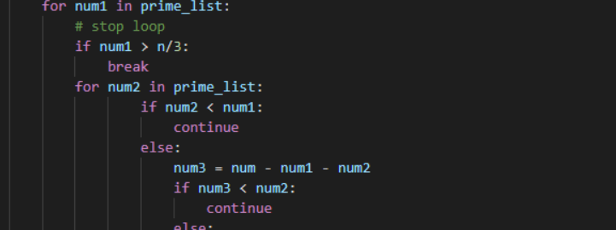
Code scripts

Slide 18
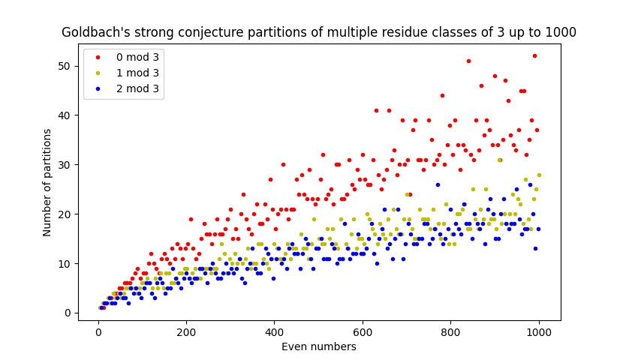
Goldbach’s Strong Conjecture Partitions Distribution
4 [(2, 2)]
6 [(3, 3)]
…
128 [(19, 109), (31, 97), (61, 67)]
…
152 [(3, 149), (13, 139), (43, 109), (73, 79)]
…
1000 [(3, 997), (17, 983), …,
(137, 863), (173, 827), …,
(479, 521), (491, 509)]

Slide 19
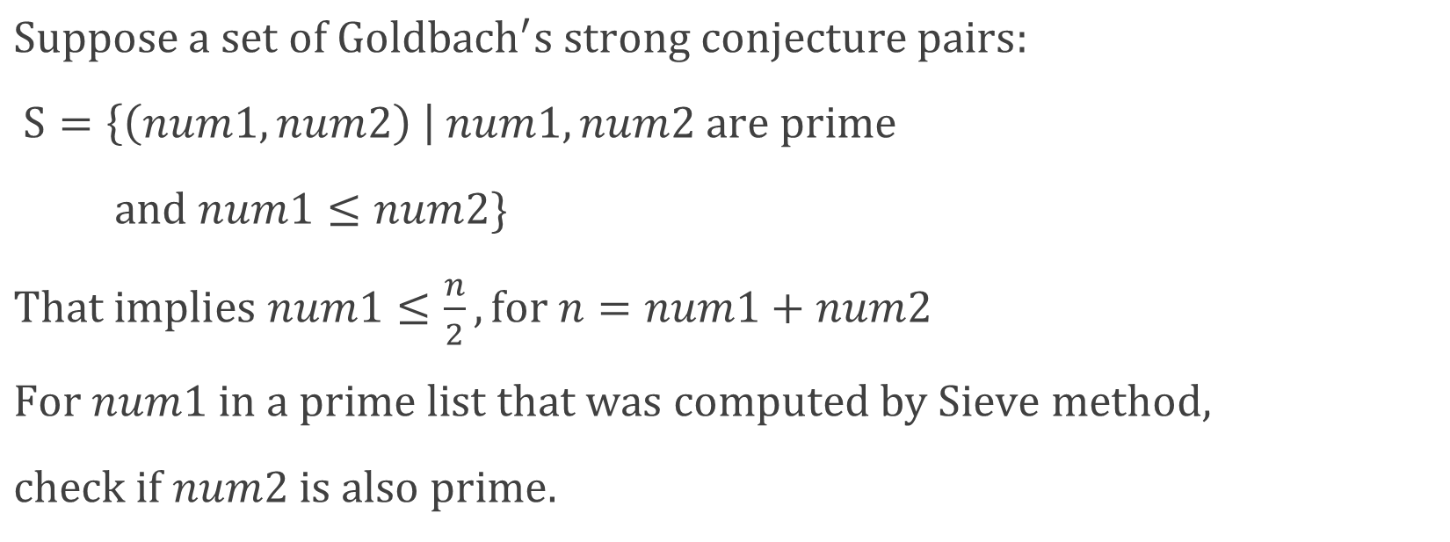
Algorithm
$Suppose a set of Goldbach^{′}s strong conjecture pairs:$
$S=\left\{\left(num1, num2\right) \right| num1, num2 are prime$
$and num1≤num2\}$
$That implies num1≤\frac{n}{2}, for n=num1+num2$
$For num1 in a prime list that was computed by Sieve method,$
$check if num2 is also prime.$

Slide 20
Code scripts

Slide 21
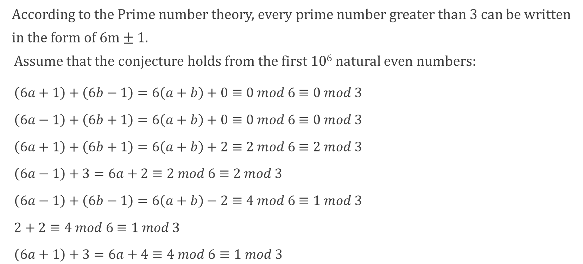
Why module 3?
According to the Prime number theory, every prime number greater than 3 can be written
in the form of 6m ± 1.
Assume that the conjecture holds from the first 10⁶ natural even numbers:
$\left(6a+1\right)+\left(6b−1\right)=6\left(a+b\right)+0≡0 mod 6$ $≡0 mod 3$
$\left(6a−1\right)+\left(6b+1\right)=6\left(a+b\right)+0≡0 mod 6$ $≡0 mod 3$
$\left(6a+1\right)+\left(6b+1\right)=6\left(a+b\right)+2≡2 mod 6$ $≡2 mod 3$
$\left(6a−1\right)+3=6a+2≡2 mod 6$ $≡2 mod 3$
$\left(6a−1\right)+\left(6b−1\right)=6\left(a+b\right)−2≡4 mod 6$ $≡1 mod 3$
$2+2≡4 mod 6$ $≡1 mod 3$
$\left(6a+1\right)+3=6a+4≡4 mod 6≡1 mod 3$

Slide 22
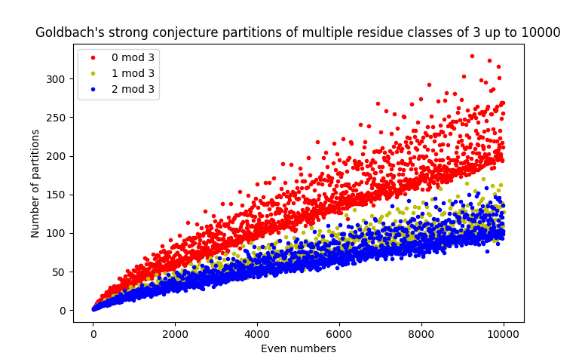

Slide 23
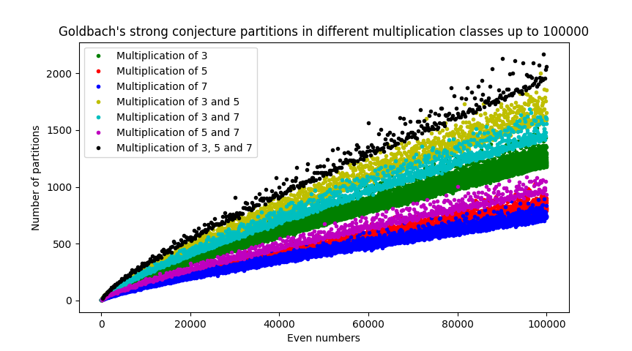

Slide 24
Conclusion
The graphs can probably be explained as a consequence of how the number of partitions varies between different congruence classes.
It just expresses the number of partitions up to 10⁶, but it is clear that the number of partitions is steadily rising.
That would be assumed that the probability of finding a Goldbach pair for large numbers is more than the smaller ones’, which means the conjecture holds.

Slide 25
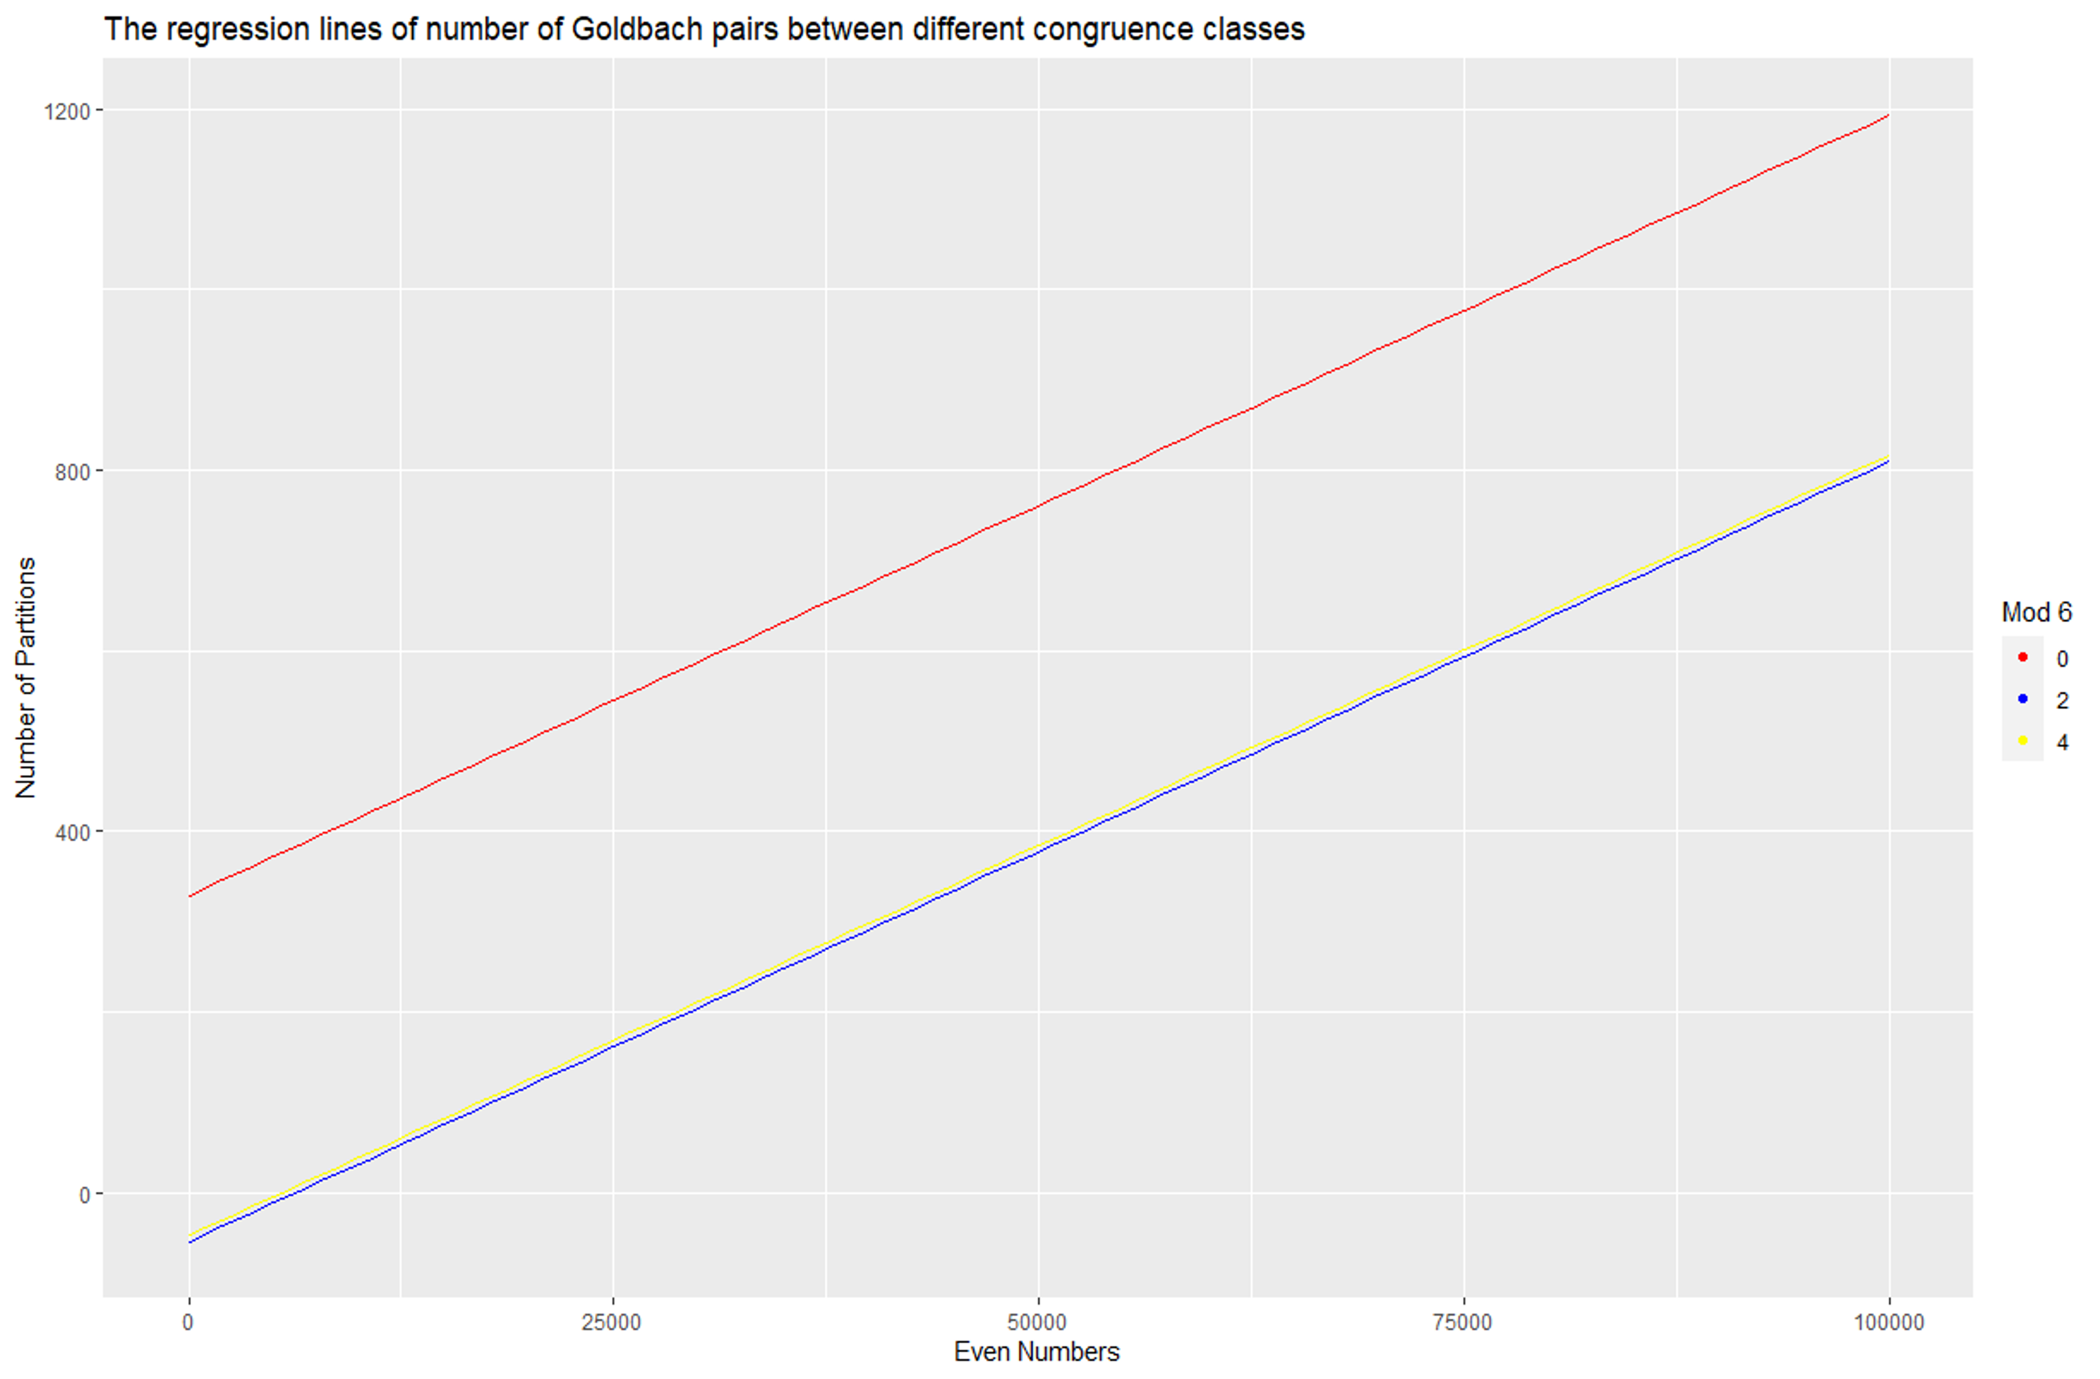

Regression Line
Mod 3
0
2
1
Call:
lm(formula = y ~ ., data = data)
Residuals:
Min 1Q Median 3Q Max
-327.66 -81.93 4.36 66.49 1027.92
Coefficients:
Estimate Std. Error t value Pr(>|t|)
(Intercept) 3.286e+02 1.399e+00 234.9 <2e-16 ***
x 8.642e-03 1.978e-05 436.8 <2e-16 ***
r2 -3.834e+02 1.399e+00 -274.1 <2e-16 ***
r1 -3.765e+02 1.399e+00 -269.1 <2e-16 ***
---
Signif. codes: 0 ‘***’ 0.001 ‘**’ 0.01 ‘*’ 0.05 ‘.’ 0.1 ‘ ’ 1
Residual standard error: 127.7 on 49995 degrees of freedom
Multiple R-squared: 0.8526, Adjusted R-squared: 0.8526
F-statistic: 9.638e+04 on 3 and 49995 DF, p-value: < 2.2e-16
$$y= β_{0}+β_{1}x+β_{i}∗(r=0)$$
Regression functions:
For 0 mod 3: y = 3.286e+02 + 8.642e-03*x
For 1 mod 3: y = 3.286e+02 + 8.642e-03*x - -3.765e+02*1
For 2 mod 3: y = 3.286e+02 + 8.642e-03*x - 3.834e+02*2

Slide 26
Conclusion
Based on the regression analysis to see the relations between the number of partitions and the natural even number, as expected, the even numbers in group 0 mod 3 have more Goldbach pairs than the ones in groups 1 and 2 mod 3. I also see that the slope of the 0 mod 3 group fit line is over twice the slope of the others. The slope of group 1 and 2 mod 3 fit lines are likely close.

Slide 27
References
“Goldbach’s conjecture” Wikipedia, Wikimedia Foundation, https://en.wikipedia.org/wiki/Goldbach%27s_conjecture.
“Goldbach’s weak conjecture” Wikipedia, Wikimedia Foundation, https://en.wikipedia.org/wiki/Goldbach%27s_weak_conjecture.
“Sieve of Eratosthenes” Wikipedia, Wikimedia Foundation, https://en.wikipedia.org/wiki/Sieve_of_Eratosthenes.
“Goldbach’s comet” Tobin, Richard, https://www.cogsci.ed.ac.uk/~richard/goldbach.html.
“Prime number”, Wikipedia, Wikimedia Foundation, https://en.wikipedia.org/wiki/Prime_number.

